Slide 1
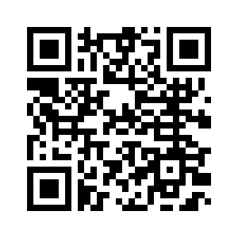
COMPUTER SCIENCE CLUB
Intro To Python (pt. 2)
Tony

Slide 2
CS Club
Data Structures

Slide 3
List
List: holds a list of information
Defined using square brackets
Items start counting from 0 (index)
Can store different types of values
Ex. abc = [1, 2, “a”, None]
To access an element: list_name[idx]
To add an element: list_name.append(new_item)
To remove an element: list_name.remove(item_to_remove)

Slide 4
Tuples
Similar to a list
Defined using circle brackets
Items start counting from 0
Items cannot be added or deleted, and order cannot be changed

Slide 5
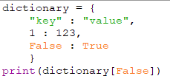
Dictionaries / Hashmaps
Key Value Pairs
Defined using curly brackets and colons
Access using the “Key” which gives you the “Value”
No duplicates keys
NO INDEX!
Can still go through all the keys & values if you’d like

Slide 6
Sets
Similar to dictionaries, but rather than having a value, it simply has a key
Also defined using curly brackets
Unordered, but can still iterate through them
Similar restrictions and features
No duplicates
NO INDEX!

Slide 7
Sets
To create: set(), or curly brackets.
To check if element already exists: if x in set
To add elements: .add()
To remove: same as list (.remove)

Slide 8
For Loops and Iterables
For lists and tuples
Can use for in, and for i in range(len(list))
What is the difference between the two?
For Dictionaries and sets
Only can use in, or use a function
.items returns both the keys and values
.values returns values

Slide 9
List Comprehension
newlist = [expression for item in iterable if condition == True]
Where expression is the output of the list comprehension
Item is the individual item inside the iterable
Iterable is the iterable (list, tuple, string, etc.)
Condition filters the input
https://www.w3schools.com/python/python_lists_comprehension.asp for more detail

Slide 10
Activity
For beginners:
Create for loops that sums a list, tuple and a set
For advanced:
Use list comprehension to filter a list to only include odd numbers

Slide 11
CS Club
While Loops

Slide 12
While Loops
Loops based on a condition
While (condition)
Can be used as a for loop
Better use case:
Checking if a user input is valid
Looping until a signal is sent (such as exit)

Slide 13
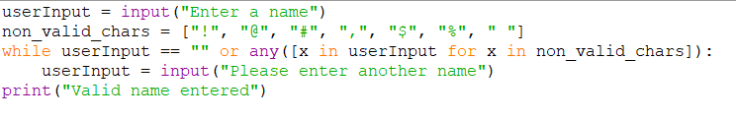
Example Code
No
Asks for an input
Predefined list of bad characters
While the input is empty, or contains a bad character, ask for a new input

Slide 14
Activity
For beginners:
Recreate the while loop but only allow characters in the alphabet
For advanced:
Use regex and recreate the while loop to only allow characters from the alphabet
Regex: short for regular expression
String of text that allows you to check whether a string matches a certain pattern
Check out regex101.com for more info

Slide 15
CS Club
Functions

Slide 16
Definition?
What is a function?

Slide 17
Definition
Reusable piece of code that does a specific task
“Boxes”

Slide 18

Definition!
Started with def, for define
Parameters pass in data
Return gives data back

Slide 19
Calling
Result = functionName(1, 2)
Return values will be wasted without assigning to a variable, or passing to something which uses the data (such as another function)
Parameters are passed in, in order with the parameters in the definition

Slide 20
Activity
Beginner:
Make a function that multiplies two numbers together, and call that function with 2 user inputs. Print out the output.
Advanced:
Make recursive function that calculates the prime numbers up to a number.

Slide 21
THANK YOU!

